Slide 1

Python & Data Science Training Project 1 – EV Adoption Analysis

Slide 2
Purpose of the Study
This project examines some possible causes to the differences in electric vehicle (EV) adoption at the level of US states. Typical questions to ask (or hypotheses to raise in terms of statistics):
1) EVs are more expensive than gas cars. Do states with higher average income show higher EV adoption?
2) Some states such as California and Nevada have better solar potential. How does this impact EV adoption?
3) EVs still have the following two limitations:
An EV typically has a driving range of 70 to 100 miles,
Currently one charge takes at least 30 minutes in those fast-charging stations.
These limitations make EV unlikely to be a good choice for long-distance driving. Therefore, EVs are
more popular among people living in or near cities where driving distances are generally shorter. Do
states with higher population densities tend to have higher EV adoption rates?
4) Blue states are more supportive for green energy. How is this party affiliation reflected in EV adoption?

Slide 3
Python & DS Skills Learned in this Project
- Use pandas and numpy to do the following:
Reading in csv or Excel data to python.
Merging data.
Handling of missing values, including imputation for missing values.
Impact of outliers, and why they should be usually be excluded.
Correlation between variables/columns.
- Use matplotlib and seaborn to visualize data and findings.
- Use statsmodel to run a regression analysis to extract insights from data.
In this exercise, we will not build predictive models. (Project 5 will address to this.)
- Use geopandas to visualize EV adoption on the US map.

Slide 4
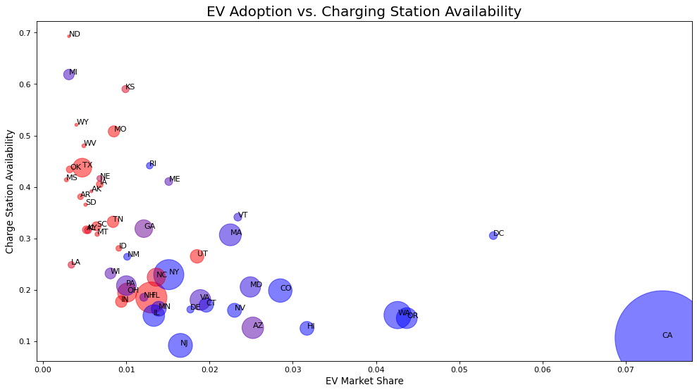
Example of visualization - EV market share increases from red states to purple states and to blue states.

Slide 5
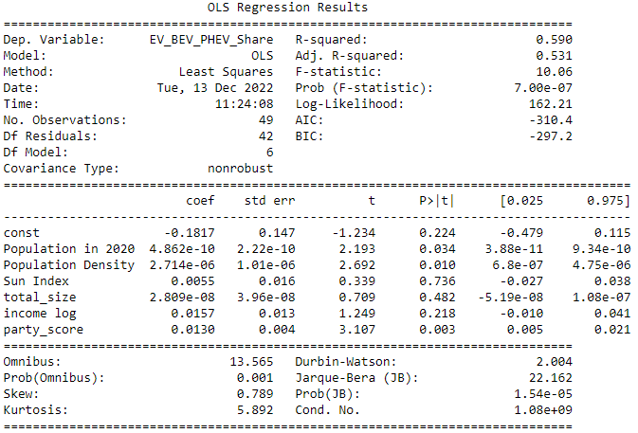
Regression Analysis
Findings from the regression analysis:
Population size, population density and party affiliation have impact on EV adoption.
Solar potential and income have no impact.

Slide 6
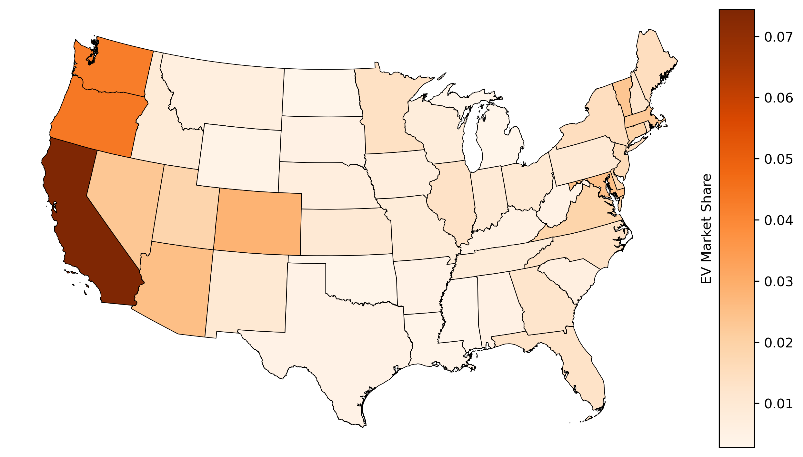
Geo Mapping - West states lead in EV adoption.

